Slide 1
Multiple relationships between the same two tables
Management Information Systems
Disha Parkhi

Slide 2
Outline
Multiple relationships between the same pair of tables:
  The College
Reading:
Chapter 8: 171-184
We are doing only one example in class, the other examples in the chapter are good practice exercises.

Slide 3
The College
DB Design Exercise
Note: for the sake of saving time, in class, we are going to work on a simplified version of the corresponding problem from the book.

Slide 4
We want to keep basic information about courses, instructors, and departments. We need to keep information about students' schedules for the current semester, and their grades from prior courses (we may also store their schedules from prior semesters if we wish). We also want to store instructors' schedules for both the current semester and past ones.
The college consists of departments, identified both by their full names and by unique three-letter codes such as ENG, MTH, CIS, MAN, and so forth.
Each instructor has a home department. We wish to store the home department, and to keep basic contact information on each instructor, including name, office address, email, and office phone.

Slide 5
Courses are identified by a three-letter department code and a three-digit course number, such as ENG101. Each course has a name and a description.
Courses may have multiple sections, which are identified by one additional letter appended to the course name, as in CIS223A. Sometimes there is only one section of a course (in which case it is usually "A"), but sometimes there are multiple sections, as in ENG101A, ENG101B, and ENG101C.
Each semester, a single instructor is responsible for each section. This instructor is usually in the same department as the course, but does not have to be.

Slide 6
Each semester, a student can take multiple courses. You want to use the database to store student schedules, that is, the sections being taken by each student each semester. Once the semester is over, you want to store the student's grade in each class.
Finally, you want to store contact information for each student (name, campus address, phone number, and e-mail).
After their first few semesters, the students declare themselves as having a single major in a department. They may also declare a single minor in a different department. You want the system to store major and minor information for all students. Neither multiple majors nor multiple minors are allowed.
Draw a database outline and an entity-relationship diagram.

Slide 7
The problem on the book is different than the one we solved in class. It additionally requires that:
One particular instructor is designated as the chairperson of a department. We want our system to be able to store the current chairperson for each department (we don't need information about past chairpersons).
Each section also has a room number and a time slot, such as MWF10AM, for Monday/Wednesday/Friday at 10 AM. You want to store a table of time slot codes and their meaning. Sometimes a course can have more than one section in the same time slot.

Slide 8
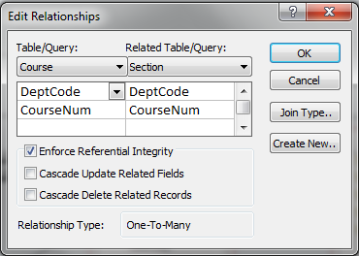
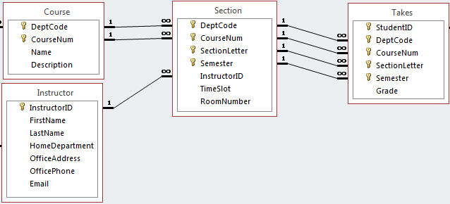
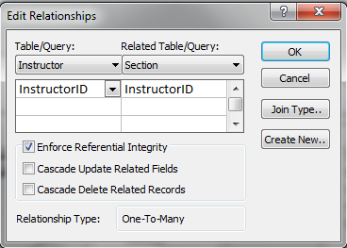
A relationship with composite keys in Access
These both correspond to a single relationship!
A relationship where the PK/FK is composite has both fields of the PK and FK here
A relationship where the PK/FK is not composite has a single field corresponding to the PK and FK here

Slide 9
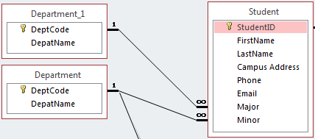
Multiple relationships between the same two tables in Access
After creating the first relationship between STUDENT and DEPARTMENT, establishing the second relationship cannot be done the same way. If we drag the primary key of DEPARTMENT to the second foreign key in STUDENT, we get a warning that a relationship already exists. The dialog box asks if we want to edit the existing relationship, or create a new one. If we click “no” to create a new relationship, and then click “enforce referential integrity” and “OK”, we get the desired result.
The second “table” DEPARTMENT_1 in this depiction is not really a second table nor a copy of the DEPARTMENT table; this is just how MS Access shows a second relationship between the same two tables.
The way the relationships window shows multiple relationships between the same two tables is not exactly the same as we would draw in the ER diagram.

